Slide 1
voice Emotional prediction
Kinda Sulaiman: 202110811
Rayan Qoursha: 202111153
Nagham Al-Otaibi: 202110560
Jumana Abu-Snaineh: 202030016
Dr. Bassam Haddad

Slide 2
Introduction
Welcome to our emotion detection in audio project, a dynamic endeavor that fuses real-world emotion expressions from movies and series with synthetic instances generated by artificial intelligence. This project aims to develop a robust neural network model capable of accurately identifying emotions in diverse audio datasets. By leveraging transcription, Mel-frequency cepstral coefficient (MFCC) extraction, and a combination of authentic and AI-generated datasets, our approach ensures a comprehensive understanding of emotions across various contexts and sources. The integration of two datasets enriches the model's training, allowing it to adapt to both natural and synthesized emotional expressions. Join us on this journey from data preparation to model deployment as we explore the intricate landscape of audio emotion recognition, bridging the gap between genuine human experiences and artificial intelligence-generated content.

Slide 3
Our limitations:
Our Arabic voices were limited in their sources and short in compilation time, so we faced some problems that affected the efficiency and accuracy of the model, such as:
2) There is no diversity in the voices we collected
1) Poor sound quality
3) Collecting a dataset in Arabic with distinguishable emotions posed a significant challenge
4) the model is struggling to convert all voices to text accurately

Slide 4
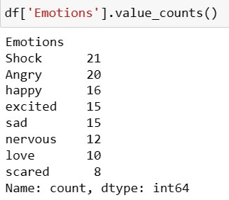
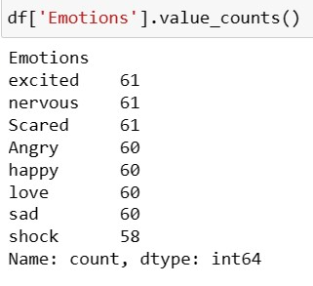
Our dataset emotions
our dataset
AI dataset

Slide 5
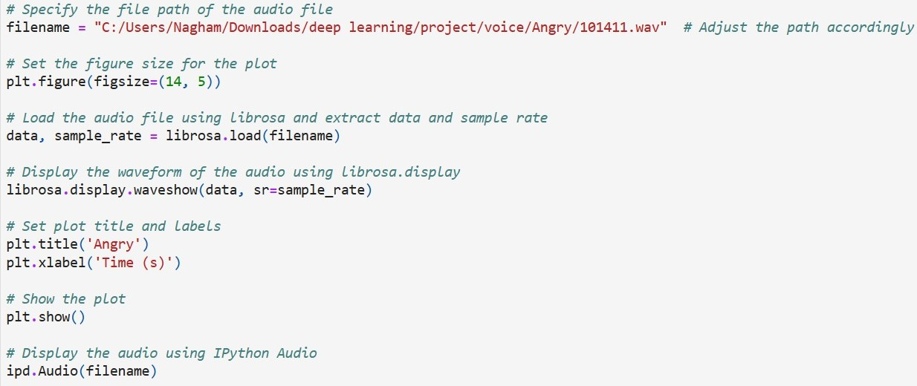
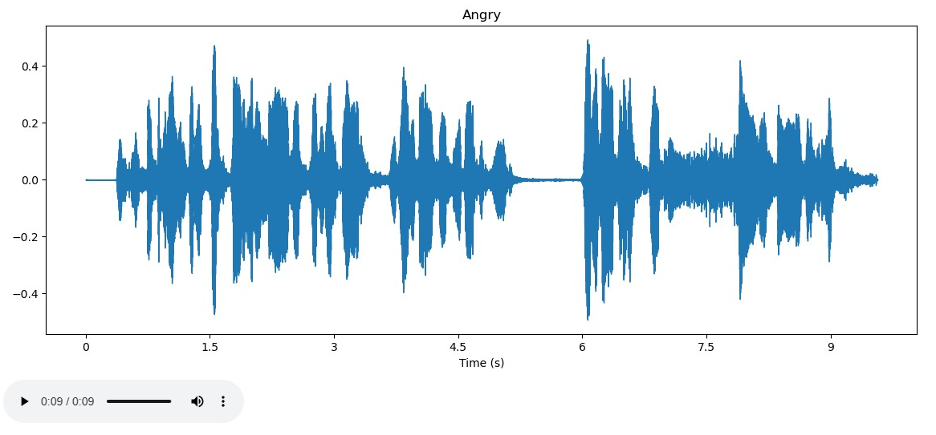

Audio Visualization
This code is designed to visualize an audio file by displaying its waveform. It begins by specifying the file path of the audio and loading it using the librosa library to extract the audio data and sample rate.
librosa : Python library used for audio analysis and processing

Slide 6
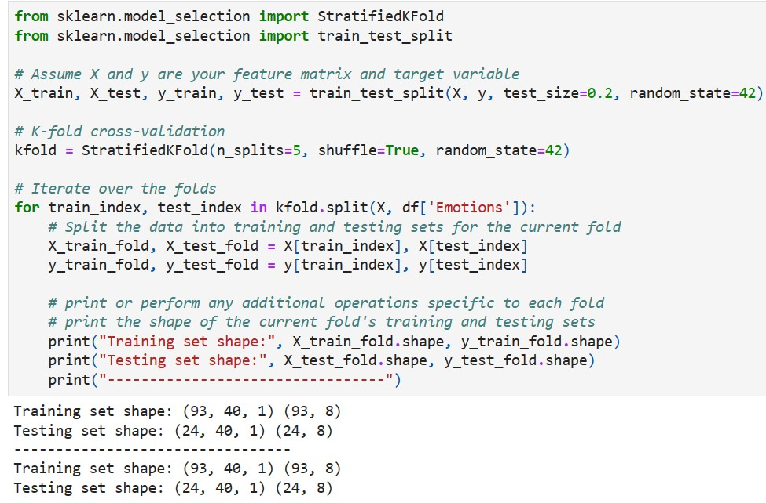
Managing Data Splits for Model Evaluation
divides the dataset into training and testing sets using a train-test split (80-20 ratio). It then applies a Stratified K-Fold cross-validation (5 folds) for robust model evaluation. The iteration loop prints the shapes of training and testing sets for each fold, providing insights into the data distribution across different splits.

Slide 7
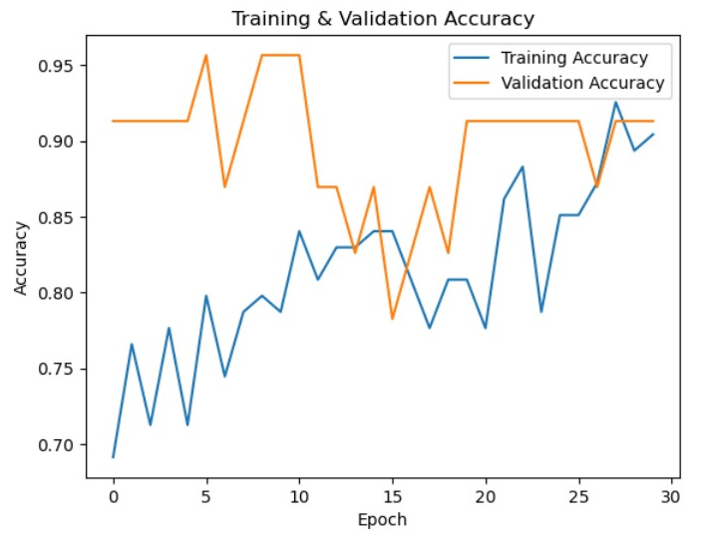
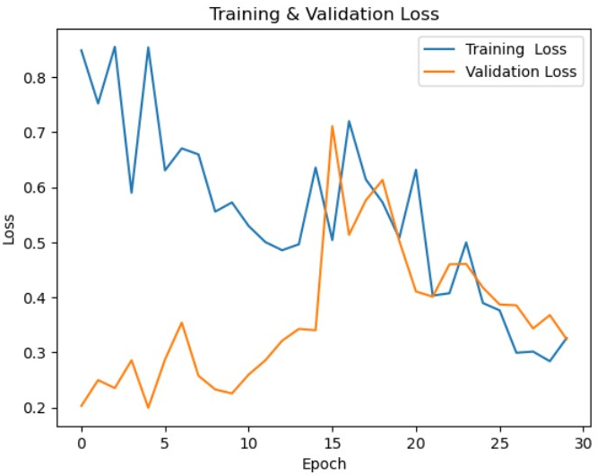
Training and Validation Accuracy Visualization
Training and Validation Loss Visualization

Slide 8
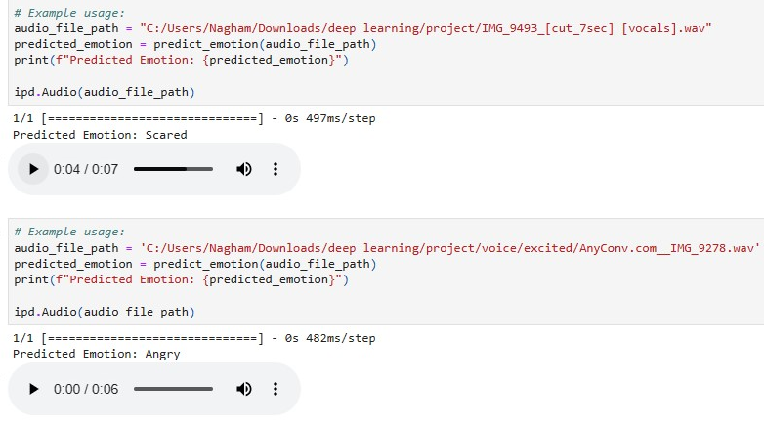
Prediction Audio

Slide 9
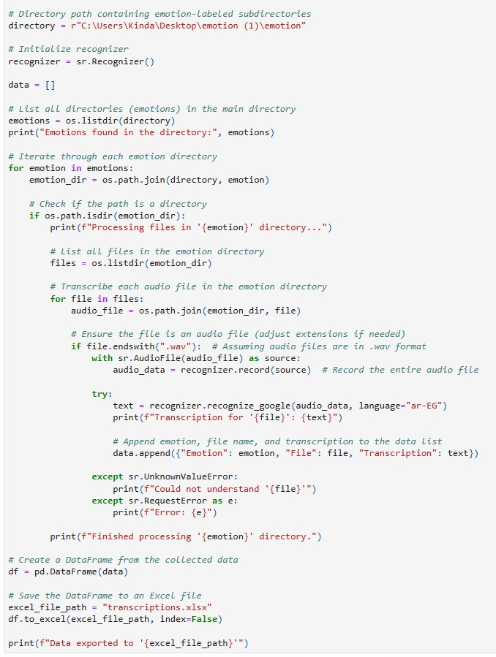
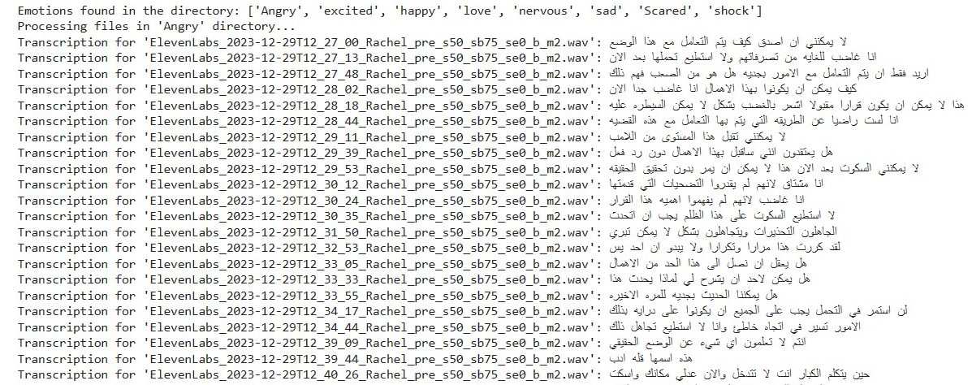
Emotion-Driven Audio Transcription with SpeechRecognition
This Python script uses the SpeechRecognition library to transcribe audio files in a specified directory. The script iterates through emotion-labeled subdirectories, processes each audio file, and saves the transcriptions along with emotion labels to an Excel file.

Slide 10
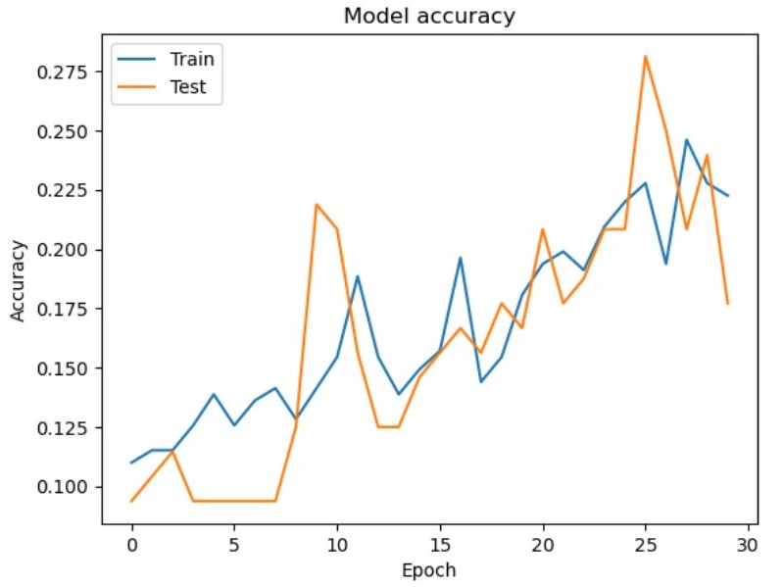
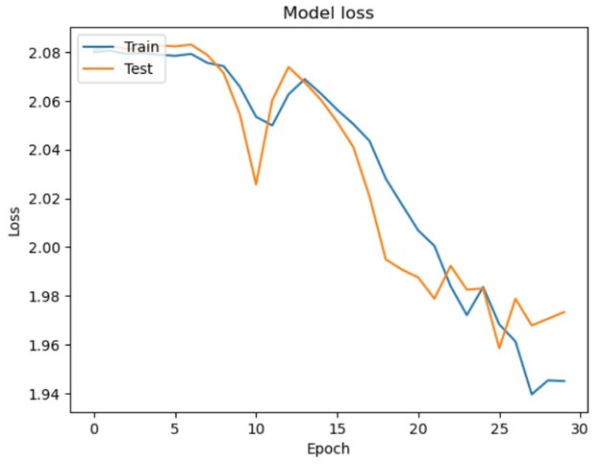
Training and Validation Accuracy Visualization
Training and Validation Loss Visualization

Slide 11
Conclusions
In our research, we delve into two key aspects. Firstly, we explore models predicting emotions based on frequencies, where each frequency corresponds to emotions like shock, happiness, or sadness. In the second part, we examine the integration of features from both text and frequencies. Notably, our findings reveal that models leveraging features from frequencies outperform those relying solely on text features. This emphasizes that data quality isn't the sole determinant; understanding emotion frequencies is crucial. Given that AI lacks inherent emotions, challenges arise in training models effectively. Consequently, our conclusion advocates for augmenting our dataset with more diverse emotional data to enhance the model's predictive capabilities.

Slide 12
Thanks!
Do you have any questions?

